Slide 1
Functional Programming in Java 8 - Part 1 - Basic Concepts & Lambdas
Lambda Expressions In Depth By Stav Alfi

Slide 2
Where we are
Functional Programming in Java 8 - Part 1 - Lambda Expressions
Functional Programming in Java 8 - Part 2 - Streams In Depth
Functional Programming in Java 8 - Part 3 - Optional and Primitive Streams
Functional Programming in Java 8 - Part 4 - Reactive Streams

Slide 3
Side Effects
Pure Functions
Variable Scope
Functional Interface
Lambda Expression
Method Reference
Lambda reads/writes
Method reference types
Streams
(next session)

Slide 4
Pre Requirements
Basic knowledge in Java
Basic knowledge in Java templates

Slide 5
Agenda
Variable scope
Side effects
Functional interface types
Lambda Expressions
Method reference types

Slide 6
Variable scope
Method
Class
Object
What is it?
Example
Notes:
איפה הערך של המשתנה יכול להיות נגיש

Slide 7
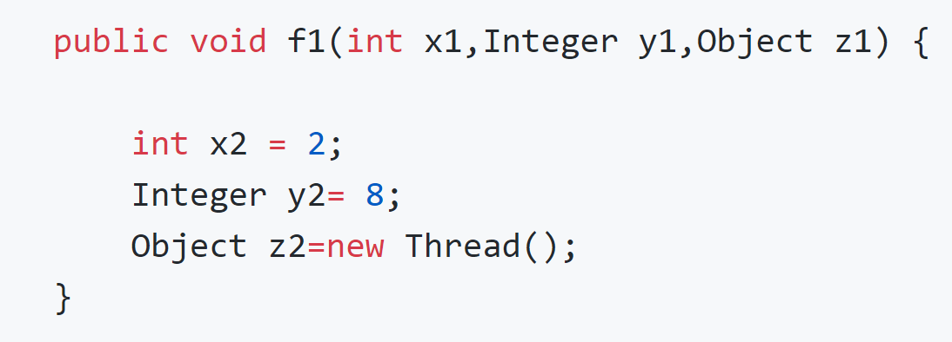
Variable scope

Slide 8
Side effects
What is it?
Example

Slide 9
Side effects
A function or expression is said to have a side effect if it modifies some state outside its scope or has an observable interaction with its calling functions or the outside world besides returning a value.

Slide 10
Pure functions
A function is said to have a pure function if it doesn’t have side effects and the function always evaluates the same result value given the same argument value(s)

Slide 11
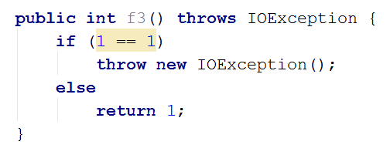
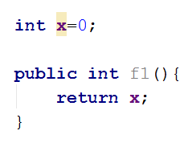
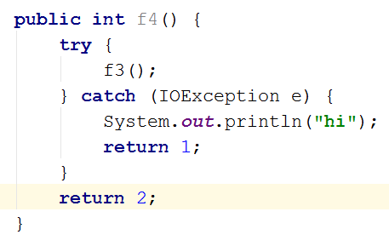
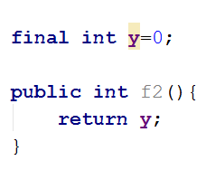
Examples

Slide 12
Functional interfaces
What is it?
Examples
Using Anonymous class to implement them
Are side effects allowed while implementing them?

Slide 13
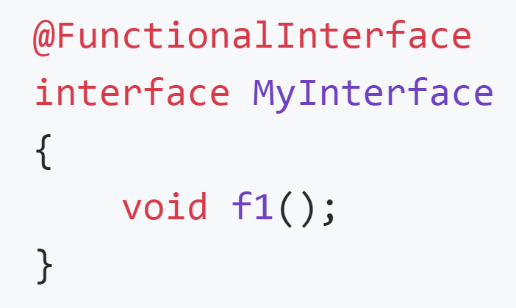
Functional Interfaces
Examples

Slide 14
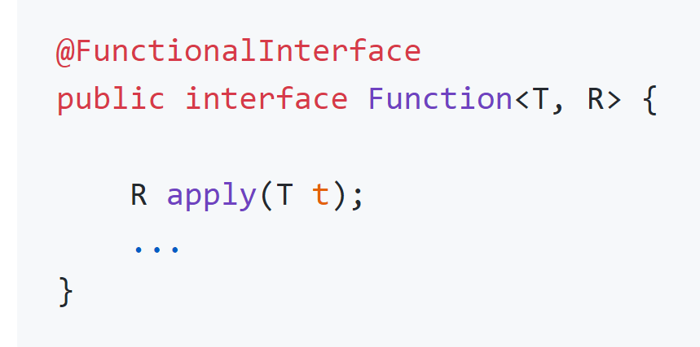
Functional Interfaces
Examples

Slide 15
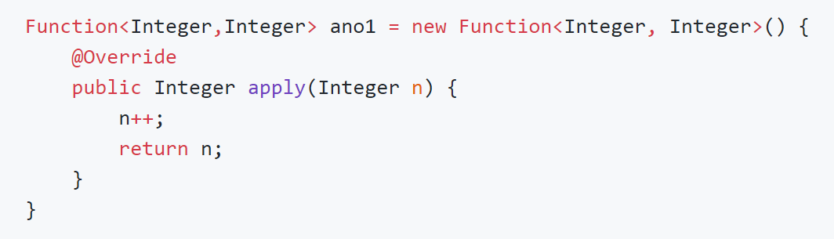
Implementing using anonymous class
Functional Interfaces

Slide 16
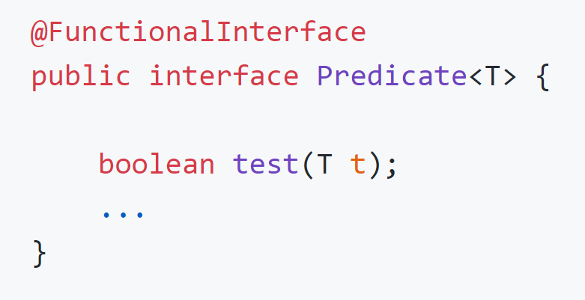
Functional Interfaces
There should be no side effects while implementing most functional interfaces

Slide 17
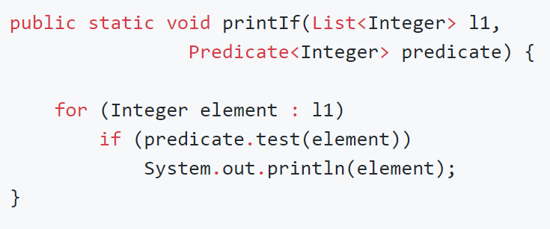
Functional Interfaces
Predicate example
Print each element which fulfills a condition

Slide 18
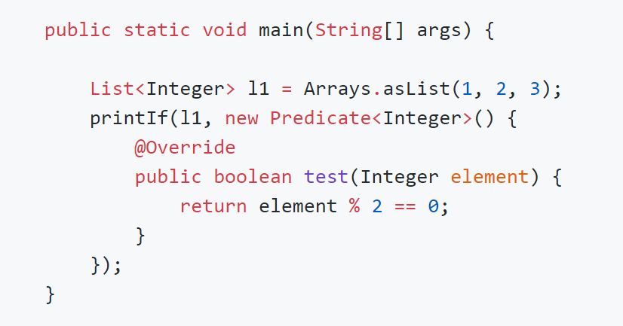
Functional Interfaces
There should be no side effects while implementing most functional interfaces

Slide 19
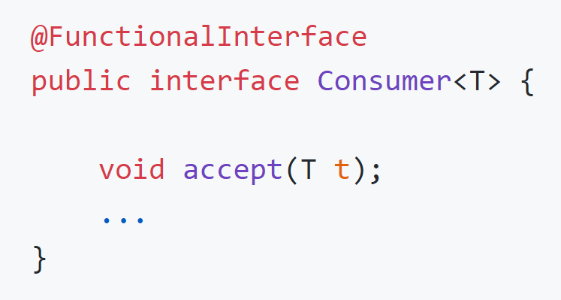
Functional Interfaces
There should be no side effects while implementing most functional interfaces

Slide 20
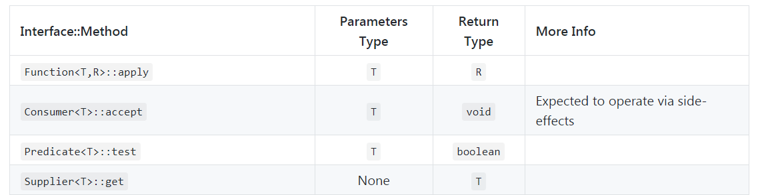
Step back - Functional Interfaces Family
Comparator
before Java-8: Callable<T> + Runnable + Comperator<T>

Slide 21
Functional Interfaces
Passing behaviors, not only values.
Do not create functional interfaces.
Provide us a way to implement lambda expressions.

Slide 22
Lambda expressions
What is it?
Examples
What does it compile to?
Does side effects are allowed?
Variable scope

Slide 23
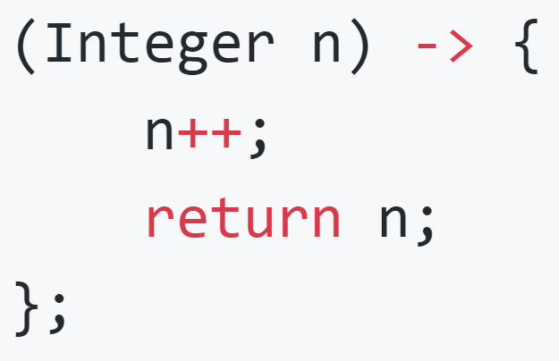
Lambda expressions
What is it?

Slide 24
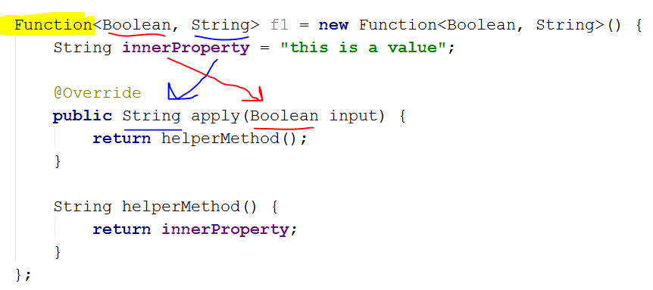
Lambda expressions

Slide 25
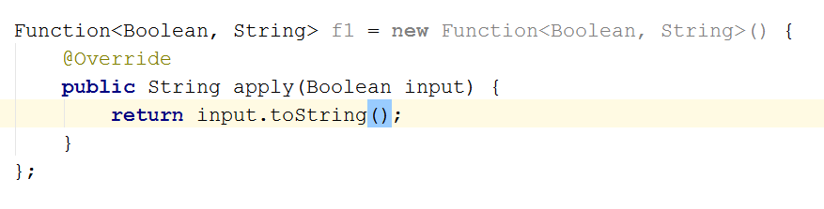
Lambda expressions

Slide 26
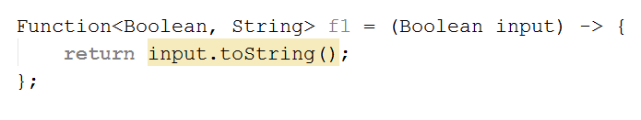
Lambda expressions

Slide 27
Lambda expressions
Examples

Slide 28
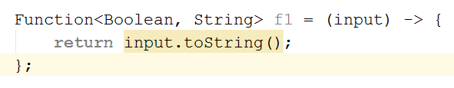
Lambda expressions
Examples

Slide 29
Lambda expressions
Examples

Slide 30
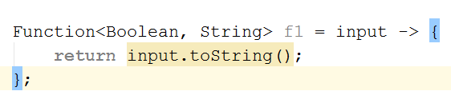
Lambda expressions
Examples

Slide 31

Lambda expressions
Examples

Slide 32
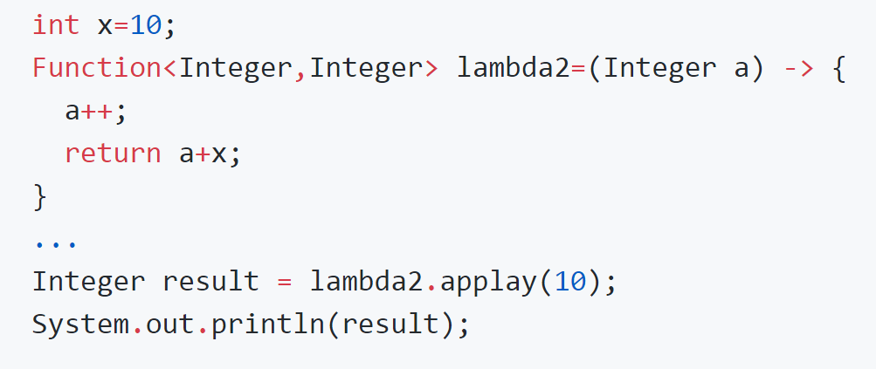
Lambda expressions
Examples

Slide 33
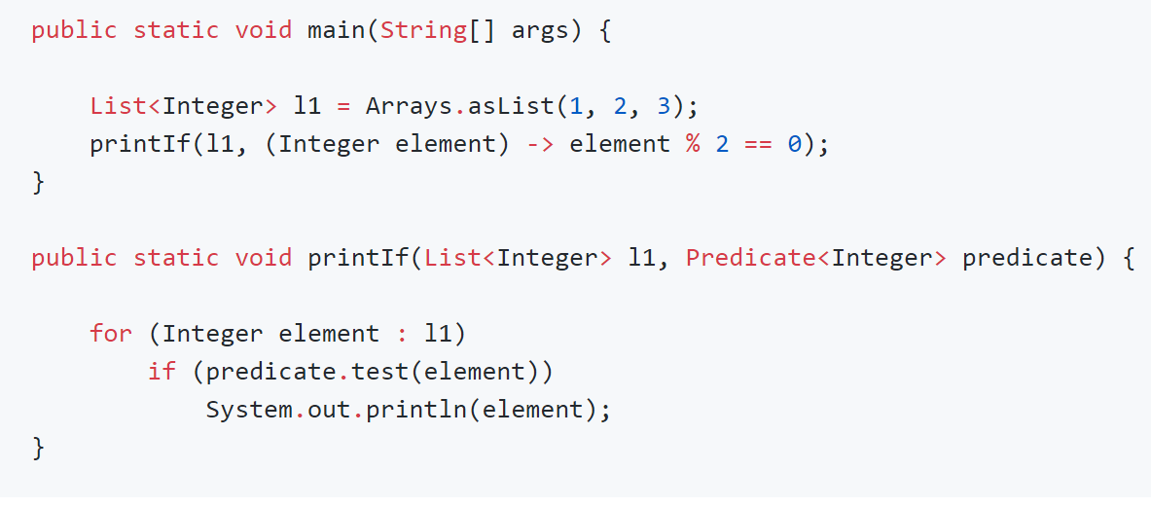
Lambda expressions
No side effects are allowed while implementing most functional interfaces

Slide 34
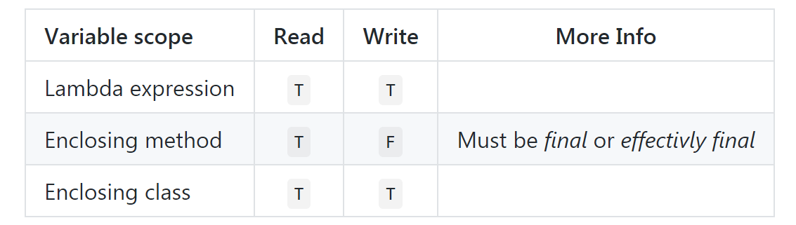
Lambda expressions
Variable scope

Slide 35
Lambda expressions
Variable scope is here for us.
Best practice – No side effects!
Best practice – Yes pure functions!

Slide 36
Method reference types
What is it?
Types
Examples
Method reference vs Lambda expression

Slide 37
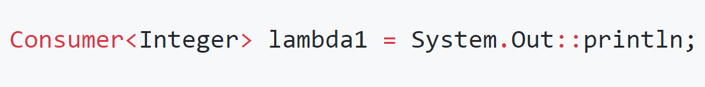
Method reference types
What is it?

Slide 38
Method reference types
Types
Object::instanceMethod
class::InstanceMethod
class::constructor
Class::staticMethod

Slide 39
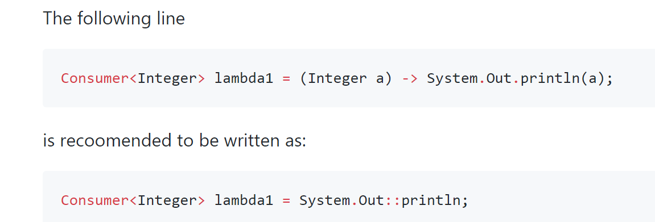
Method reference types
Object::instanceMethod
Object
Instance method

Slide 40
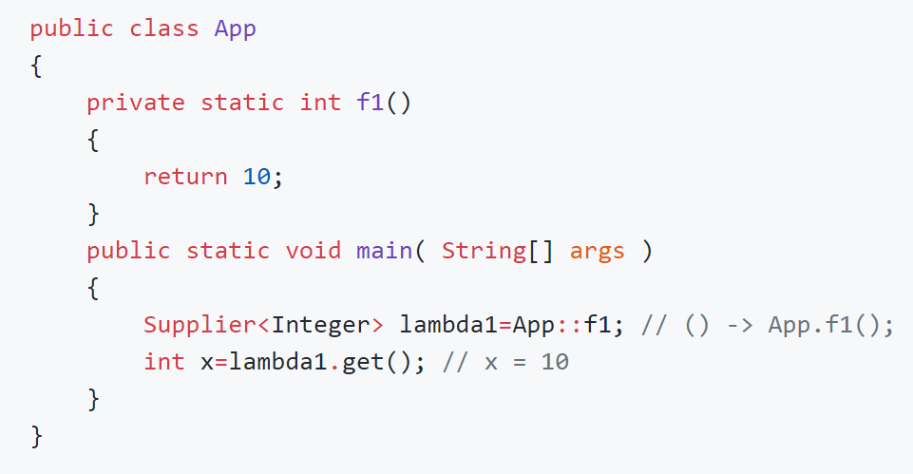
Method reference types
Class::StaticMethod

Slide 41
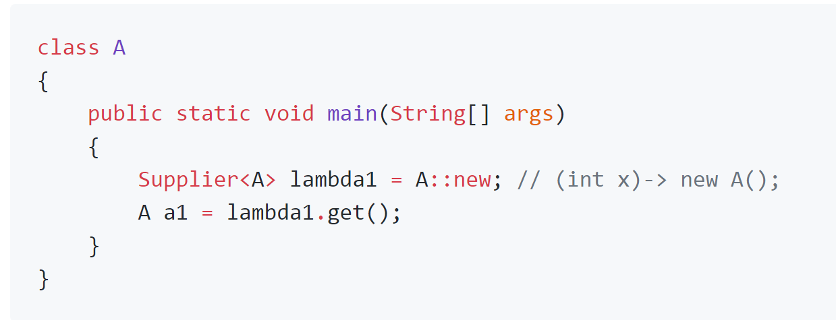
Method reference types
Class::Constructor
No params

Slide 42
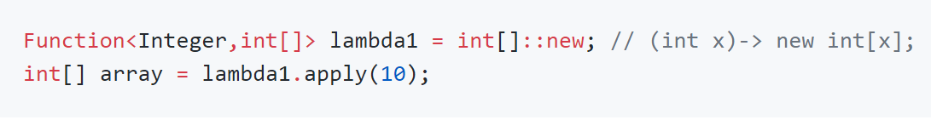
Method reference types
Class::Constructor

Slide 43
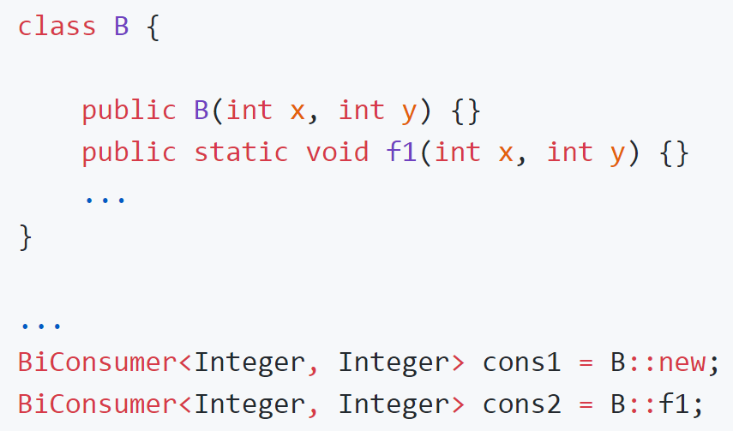
Method reference
Multiple parameters

Slide 44
Method reference
Do not use it everywhere.

Slide 45
Side effects
Functional interfaces
Lambda expressions
Method reference
Java 8 - Streams

